Slide 1
Cryptography (2022 Fall) confidentiality, integrity, authentication, non-repudiation, cryptography, private-key encryption, Kerckhoff’s principle
LiangFeng Zhang
zhanglf@shanghaitech.edu.cn
SIST, ShanghaiTech

Slide 2
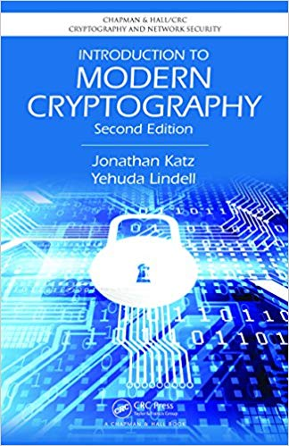
Course Information
Course Websites: lecture slides, homework questions, other materials
Piazza: https://piazza.com/class/l7comcnrkk455f (Q&As)
Blackboard: http://egate.shanghaitech.edu.cn/new/index.html
Homework Submission:
Gradescope: https://www.gradescope.com/courses/431705 (BBKDJ8)
Office Hours: SIST 2-202.i, 8-9pm, Wednesday; Lectures: Week 1-12
Textbook: “Introduction to Modern Cryptography” (2nd edition)
Authors: Jonathan Katz, Yehuda Lindell
https://www.amazon.com/Introduction-Cryptography-Chapman-Network-Security-ebook/dp/B00QFFY41K
Evaluation:
Attendance: 10%
Homework and Project: 60% (no plagiarisms!!!)
Final Exam: 30%

Slide 3
Information Security
The protection of information and information systems from unauthorized access, use, disclosure, disruption, modification, or destruction in order to provide confidentiality, integrity, and availability.
Committee on National Security Systems Glossary (CNSSI-4009)
Availability
Security
Objectives
Confidentiality
Integrity
EXAMPLE: Computer Security (under information security)
Measures and controls that ensure confidentiality, integrity, and availability of the information processed and stored by a computer.

Slide 4


Confidentiality
“Transfer $1000 from Alice to David”
Alice
Bob (bank)
Charlie
Adversary
The property that sensitive information is not disclosed to unauthorized individuals, entities, or processes.
FIPS 140-2

Slide 5
Integrity
“Transfer $1000 from Alice to David”
Alice
Bob (bank)
Charlie

Slide 6
Integrity
“Transfer $1000 from Alice to Charlie”
Alice
Bob (bank)
Charlie

Slide 7
Integrity
“Transfer $10000 from Alice to Charlie”
Alice
Bob (bank)
Charlie
The property that sensitive data has not been modified or
deleted in an unauthorized and undetected manner.
FIPS 140-2

Slide 8
Authentication
“Transfer $1000 from Alice to Charlie”
Alice
Bob (bank)
Charlie
The process of establishing confidence in the identity of users or information systems.
SP 800-63

Slide 9
Non-Repudiation
“Transfer $1000 from Alice to David”
$$I never send this instruction‼!$$
Alice
Bob (bank)
$$I never receive this instruction‼!$$
Assurance that the sender of information is provided with proof of delivery and the recipient is provided with proof of the sender’s identity, so neither can later deny having processed the information.
CNSSI-4009; SP 800-60

Slide 10
Cryptography
The study of mathematical techniques for securing digital
information, systems, and distributed computations
against adversarial attacks
“Introduction to Modern Cryptography”, Katz, Lindell, 2015
The study of mathematical techniques related to aspects of information security such as confidentiality, data integrity, entity authentication, and data origin authentication.
“Handbook of Applied Cryptography”, Menezes, van Oorschot, Vanstone, 1996
The discipline that embodies the principles, means, and
methods for the providing information security, including
confidentiality, data integrity, non-repudiation, and
authenticity.
CNSSI-4009

Slide 11
Course Outline
Classical Cryptography: Modern Cryptography (post-1980s)
Historical Ciphers; One-Time Pad
Private-Key Cryptography: share a secret key for security
Private-Key Encryption
Message Authentication Codes
Hash Functions
Practical Constructions
Public-Key Cryptography: do not share any secret key
Key Exchange
Public-Key Encryption
Digital Signature
Advanced Topics: secure computation, …

Slide 13
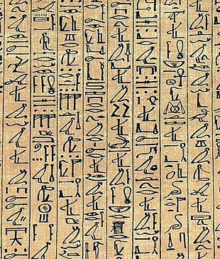
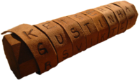
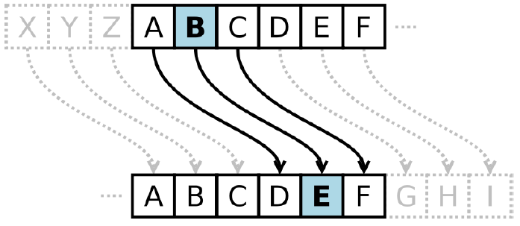
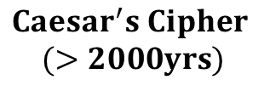
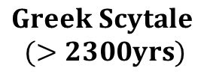
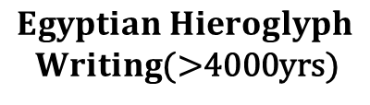
History of Encryption
$$Egyptian Hieroglyph$$
$Writing$(>4000yrs)
$$Greek Scytale$$
$(>2300yrs)$
$$Caesar^{′}s Cipher$$
$(>2000yrs)$

Slide 14
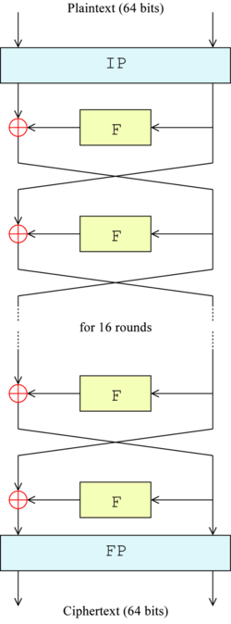
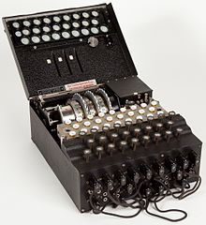
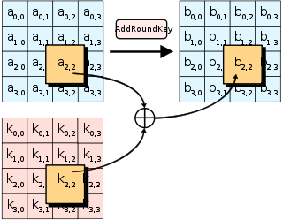
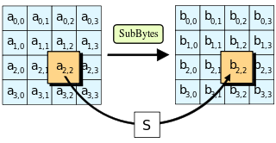
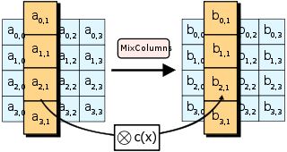
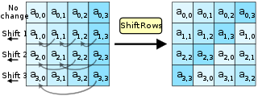



History of Encryption
$$Enigma$$
$$DES$$
$$AES$$

Slide 16
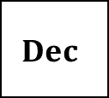


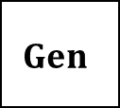

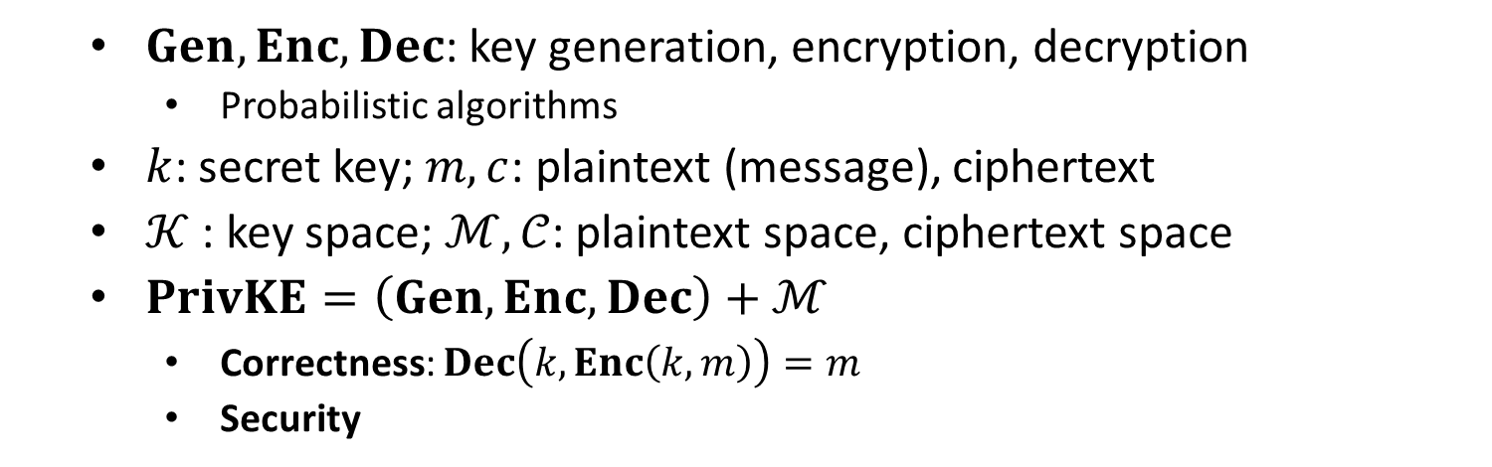
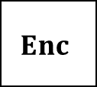


Private-Key Encryption (PrivKE)
$$m$$
$$Enc$$
$$Enc(k, m)=c$$
$$Dec$$
Alice
Bob
$$k$$
$$k$$
$$Dec(k, c)=m$$
$$Gen$$
$Gen, Enc, Dec$: key generation, encryption, decryption
Probabilistic algorithms
$k$: secret key; $m, c$: plaintext (message), ciphertext
$𝒦$ : key space; $ℳ,𝒞$: plaintext space, ciphertext space
$PrivKE=\left(Gen, Enc, Dec\right)+ℳ$
Correctness: $Dec\left(k,Enc\left(k,m\right)\right)=m$
Security

Slide 17
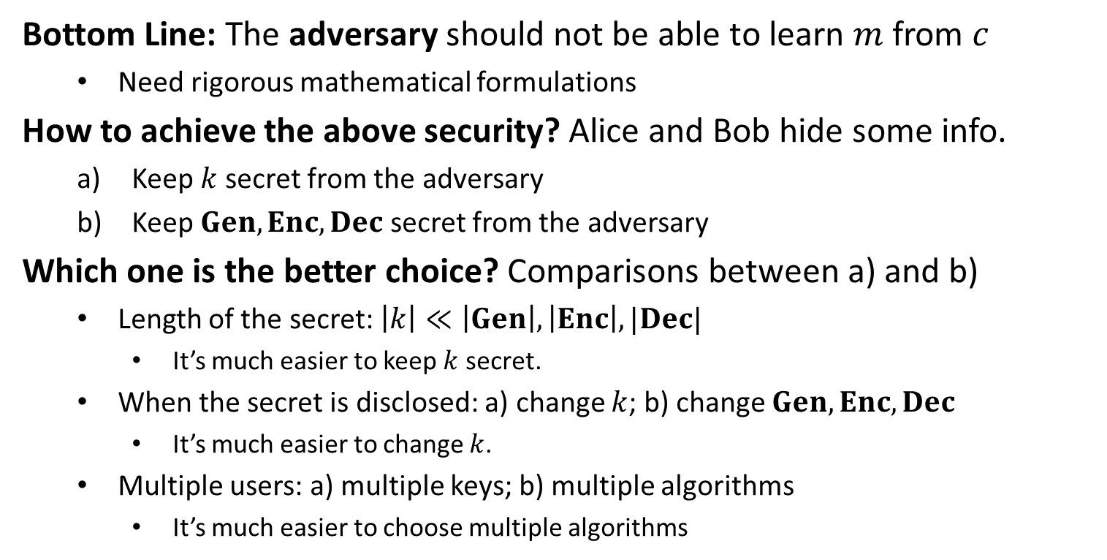
Security of PrivKE
Bottom Line: The adversary should not be able to learn $m$ from $c$
Need rigorous mathematical formulations
How to achieve the above security? Alice and Bob hide some info.
Keep $k$ secret from the adversary
Keep $Gen, Enc, Dec$ secret from the adversary
Which one is the better choice? Comparisons between a) and b)
Length of the secret: $\left|k\right|≪\left|Gen\right|, \left|Enc\right|, |Dec|$
It’s much easier to keep $k$ secret.
When the secret is disclosed: a) change $k$; b) change $Gen, Enc, Dec$
It’s much easier to change $k$.
Multiple users: a) multiple keys; b) multiple algorithms
It’s much easier to choose multiple algorithms

Slide 18
Kerckhoff’s Principle
PRINCIPLE: The cipher method must not be required to be secret, and
it must be able to fall into the hands of the enemy without
inconvenience.
Security should solely rely on the secrecy of the key
By Kerckhoff, 19th century
REMARK: Cryptographic designs (algorithms) can be made public
It’s easy to find the weakness of a design and so make improvement. Eventually, a really strong design will be obtained.
However, many designs in national security remain not public

